Slide 1



TECHNICAL REVIEW OF L463 30MY TPO WRAPPED PANELS
Jinrong (SH) Automotive Parts Corp., Ltd
22nd June 2026

Slide 2
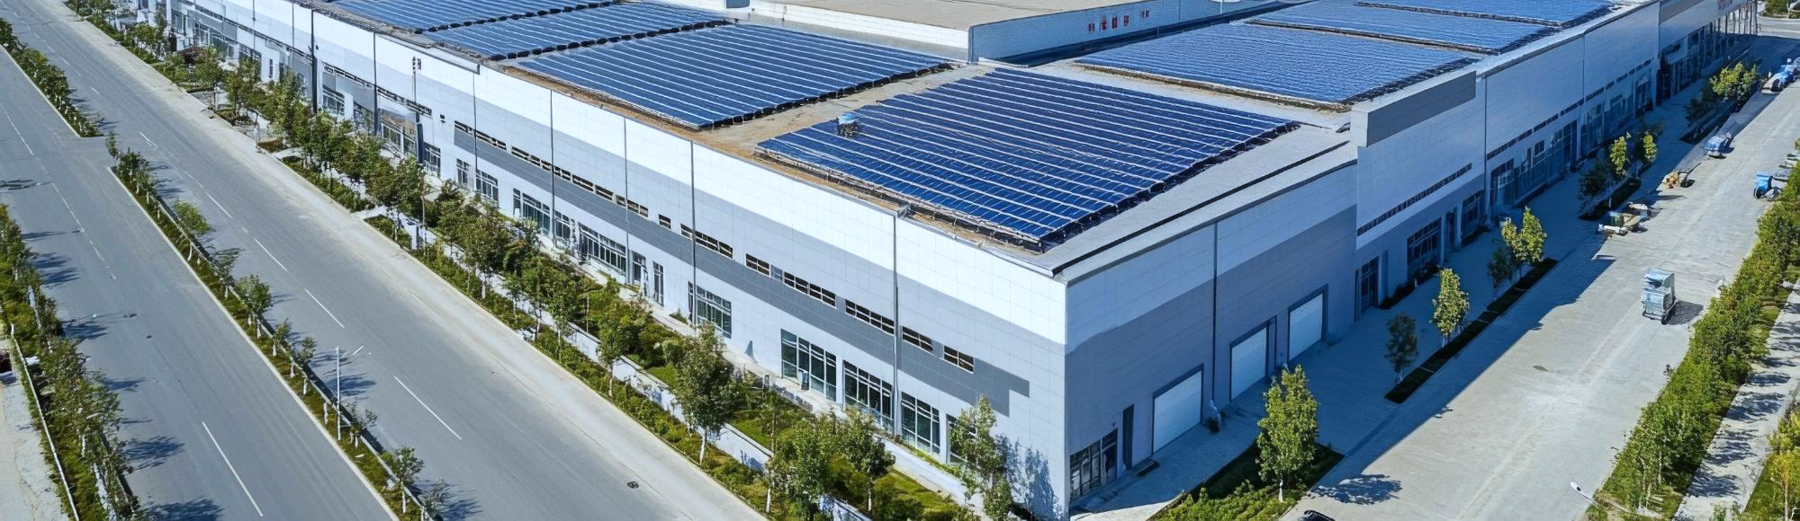
CONTENTS
PART 01
1.1 Project Basic Information
1.2 Project Development Process
1.3 Project Team Members
1.4 Project Timeline
PROJECT INFORMATION

Slide 3
1.1 Project Information
Brand
Project
Jaguar Land Rover –
Defender
L463 30MY
Logistic Terms
Average Annual Volume
CPT JLR China IEO Warehouse
10,845
PLANT
JOB1
Nitra Slovakia
11/12/2028

Slide 4
1.2 Project Development Process
Plan and Define Projects
Product Design and Development
Process Design and Development
Feasibility analysis report/project review report
Product and Process Validation
Feedback evaluation and corrective measures
Design target and quality target
Retrieve frozen data
Development Task Book
Approval of tooling & checking fixture
Continuous improvement
Initial BOM
Design approval of tooling&fixture
Design and Manufacturing of assy fixture
Project kickoff meeting
Process flowchart
Initial process flow chat
Project schedule
PFMEA
OTS Review
Specific product and process characristics
Test outline
Control plan
Functional testing
DV test
List of sub suppliers
packing design
Skill operation training
2D/3D data
New equipment/tooling and facility requirements
Inspection standards
Product quality assurance plan
PPAP Preparation
Tooling and fixture list
Technical and quality agreements with sub suppliers
PPAP recognition
Periodic review
Periodic review

Slide 5
1.3 Project Team Members

Slide 6
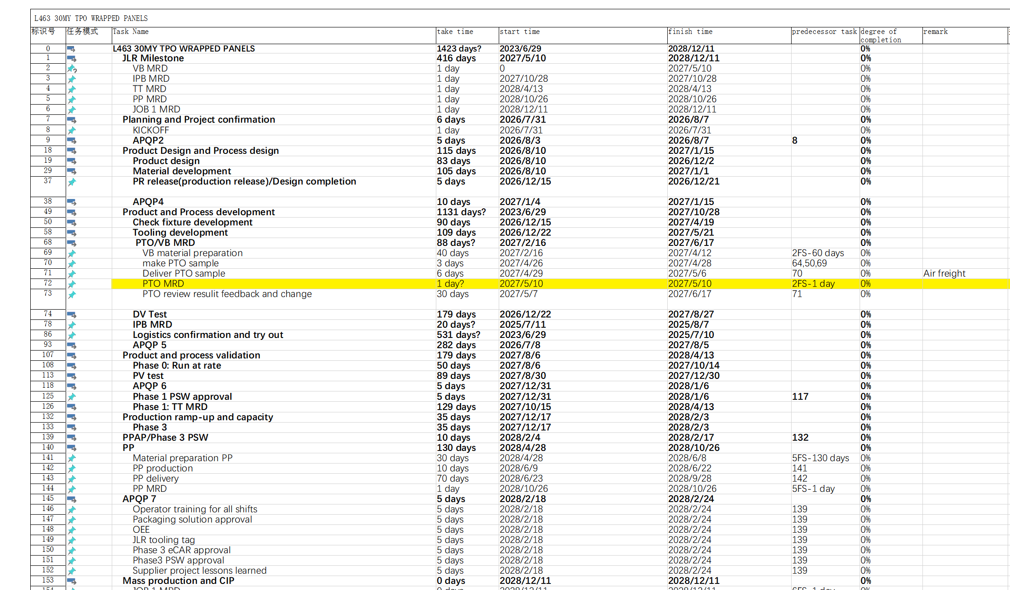
1.4 Project Timeline
PR release in Dec. 2026. VB MRD is May 10th 2027.
Time is short for tooling development and delivery.
Some parts need air freight according to the build plan of VB vehicles.

Slide 7
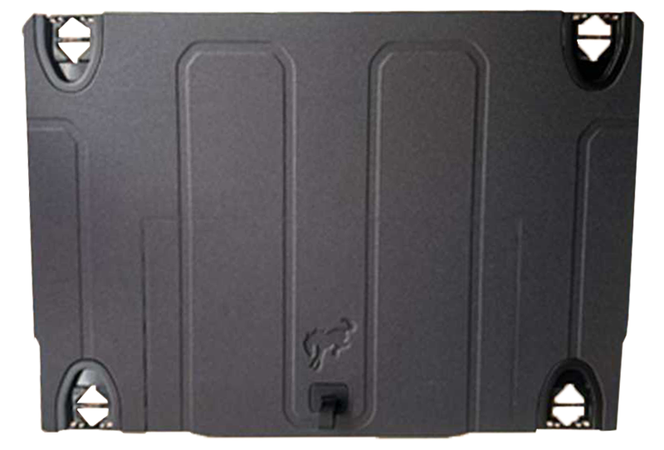
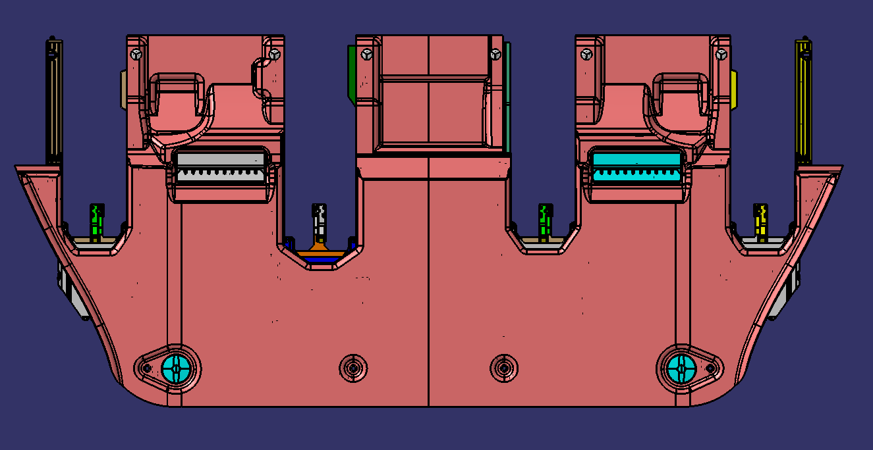
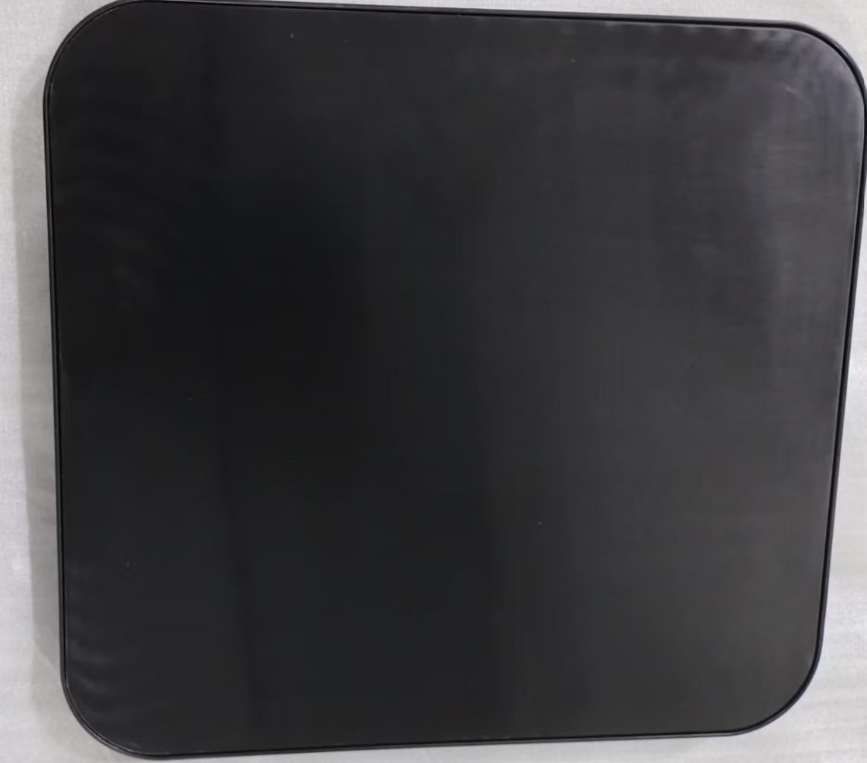
1.5 Similar Project Experience
Vehicle: LUCID Midsize SUV
Surface Layer: ：Tufted
Mid Layer: PHC( PU/AL/GF)
Backing Layer: 1000gsm PET/PP backing
Proess: Hot forming + Lamination
Vehicle: Renault XDD Interior parts
Surface Layer: TPO
TPO： 1.2mm thickness
Base: PE/MD20
Process: Mold Injection/Glue lamination
Vehicle: FORD Bronco
Surface Layer: 1000gsmTPE+100gsm Knitted Fabric
Mid Layer: PHC( PU/Paper/GF)
Backing: 120gsm Non-woven fabric
Process: PUR glue lamination

Slide 8
CONTENTS
2.1 RFQ Information
2.2 BOM
2.3 Question List
2.4 Production Process
2.5 Sub-suppliers List
2.6 PFMEA
PART 02
PARTS LIST AND
PROCESS ANALYSIS

Slide 9
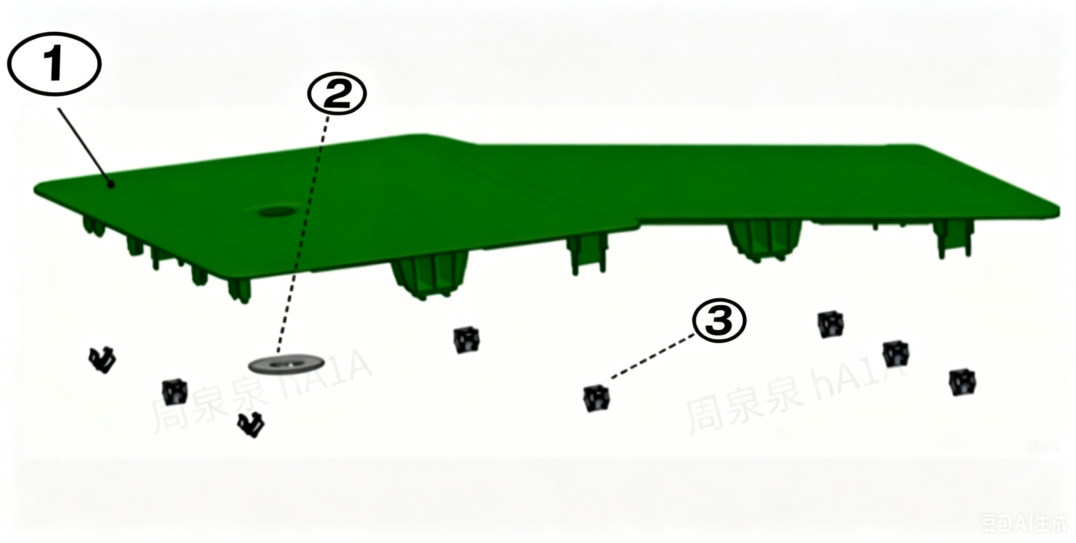
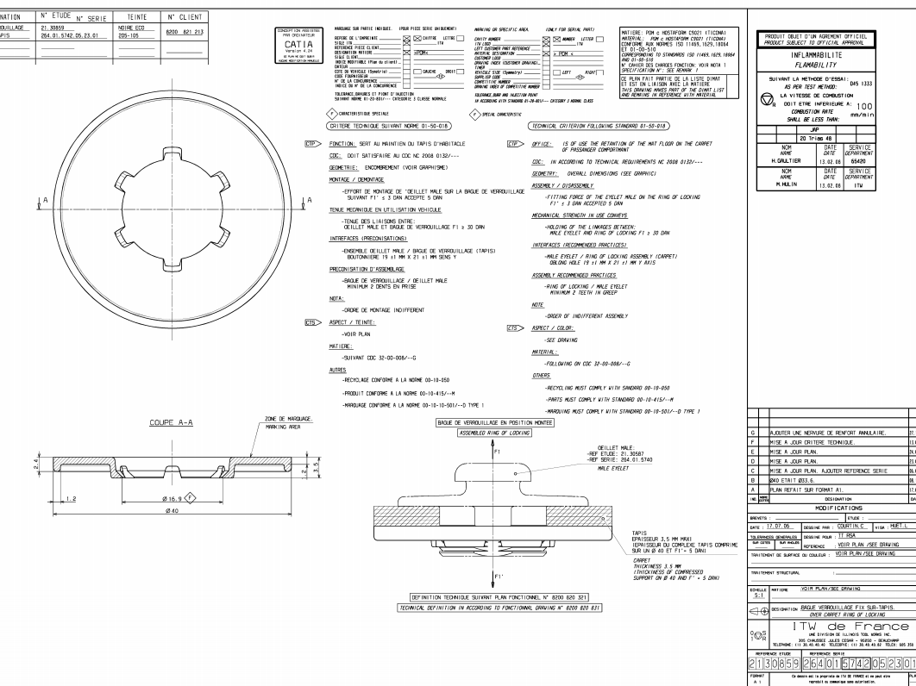
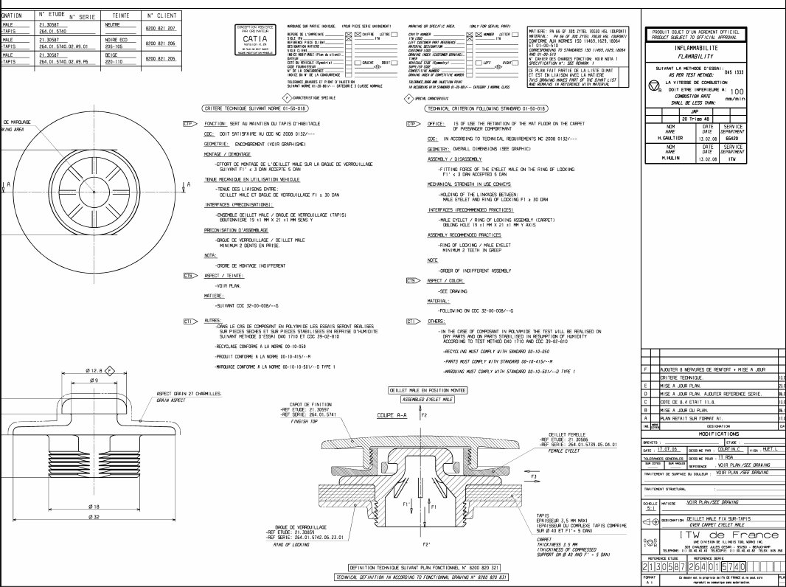
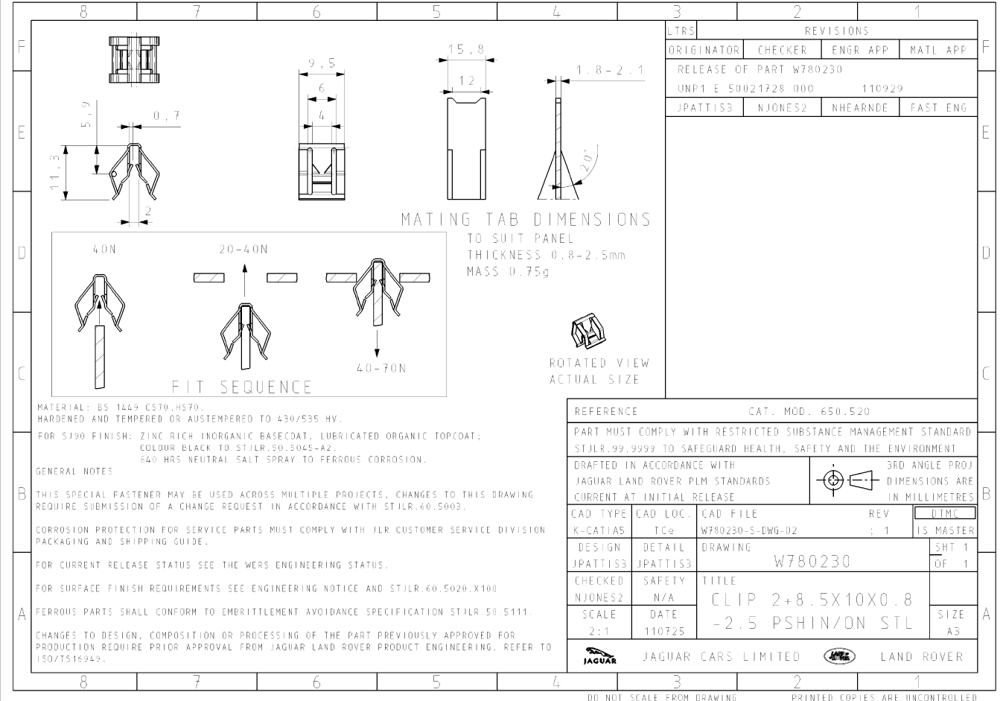
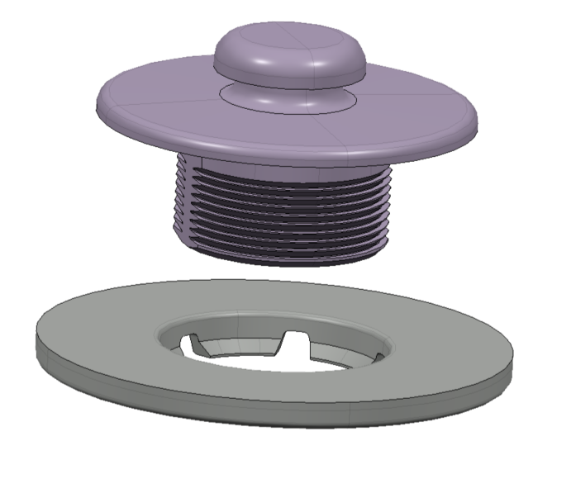
2.1 RFQ-Product
Injection moulding (grained) + Clip Assy
Exploded View: 6 SEAT ACCESS PANEL (CAD REFERENCE: EI_ Z7B2-13A994-AAW )
Sr.no. | Part Name | Qty. | Remark
1 | 6 SEAT ACCESS PANEL | 1 | IM Process
2 | ITW MAT CLIP | 1 | Clip Assy Process
3 | W780230-S CLIP STANDARD | 8 | Clip Assy Process
2
3

Slide 10
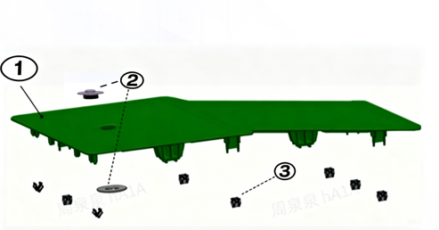
2.1 RFQ-BOM
Injection moulding (grained) + Clip Assy
No. | Part Number | PART DESIGNATION | Material Information | Size（mm） | Total Weight (kg) | Sub-supplier Proposal
1 | Z7B2-13A994-AAW | 6 SEAT ACCESS PANEL REAR | Assembly |  |  | /
1.1 | Z7B2-13A994-AAW | 6 SEAT ACCESS PANEL REAR | ABS (Magnum 3325) | 490*329*52 | 0.45 | Trinseo
1.2 |  | ITW CLIP | PA66+GF30/ POM |  | 1 couple (upper+lower) | ITW
1.3 |  | W780230-S CLIP STANDARD | BS 1449 CS70 / HS70 |  | 8 pieces
Proposed Material - ABS MAGNUM 3325
Colour – Shadow
Grain – TBC

Slide 11
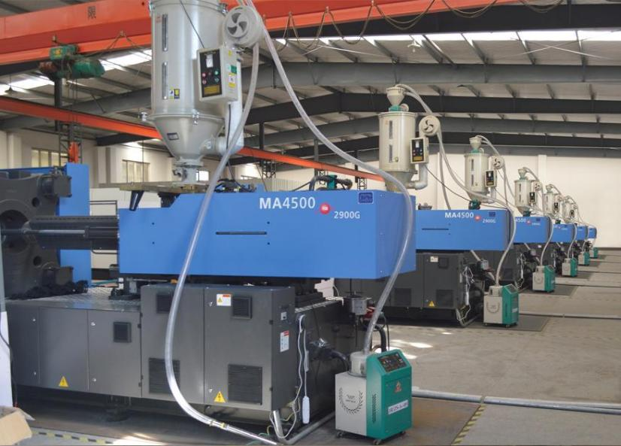
2.2 Production Process
TPO WRAPPED PANELS
Injection moulding (grained) + Clip Assy
Material Drying
Injection Molding
Packing & Cooling
Part Taking & Edge Trimming
Assembly process
Dimensional & Visual Inspection
Packaging
Tooling & Checking fixture
Equipment lists
# | Tooling | Lead time | Supplier
1 | Injection Mold*1 | 75D | /
2 | Dimensional & Visual Inspection Fixture*1 | 60D | /
# | Equipment | Type | Supplier
1 | Injection Molding Machine | 900T | /
Injection molding machine

Slide 12
CONTENTS
PART 03
3.1 Equipment List
3.2 Tooling and Gauge List
3.3 Production Capacity Analysis
LIST OF TOOLING
AND GAUGE

Slide 13
3. Production Equipment and Tooling list
# | Equipment | Existing QTY | Free Capactiy | Required Capacity | Comments
1 | Injection Molding Machine | 2 | 50% | 4% | 900T
# | Tooling | QTY | Lead time (days) | Cavity | Note
1 | Injection Mold + grain | 1 | 75 | 2 | With grain
2 | Clip Assembly fixture | 1 | 40 | 1
3 | Dimensional & Visual Inspection Fixture | 1 | 60 | 1

Slide 14
CONTENTS
PART 04
EXPERIENCE WITH SIMILAR TOOLING AND CHECKING FIXTURES

Slide 15
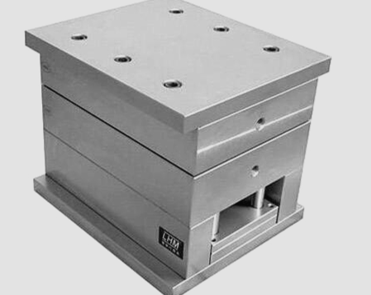
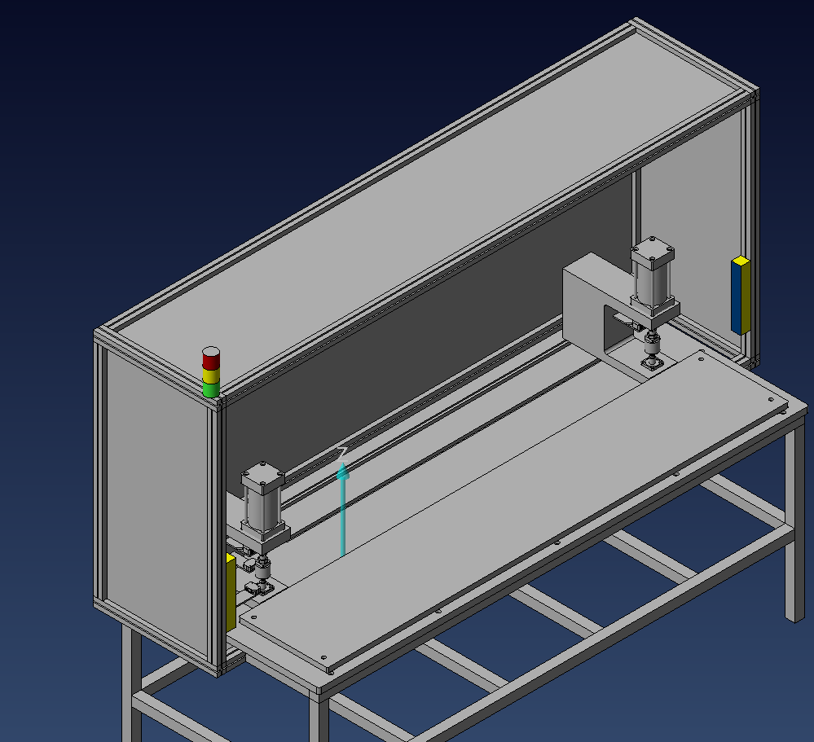
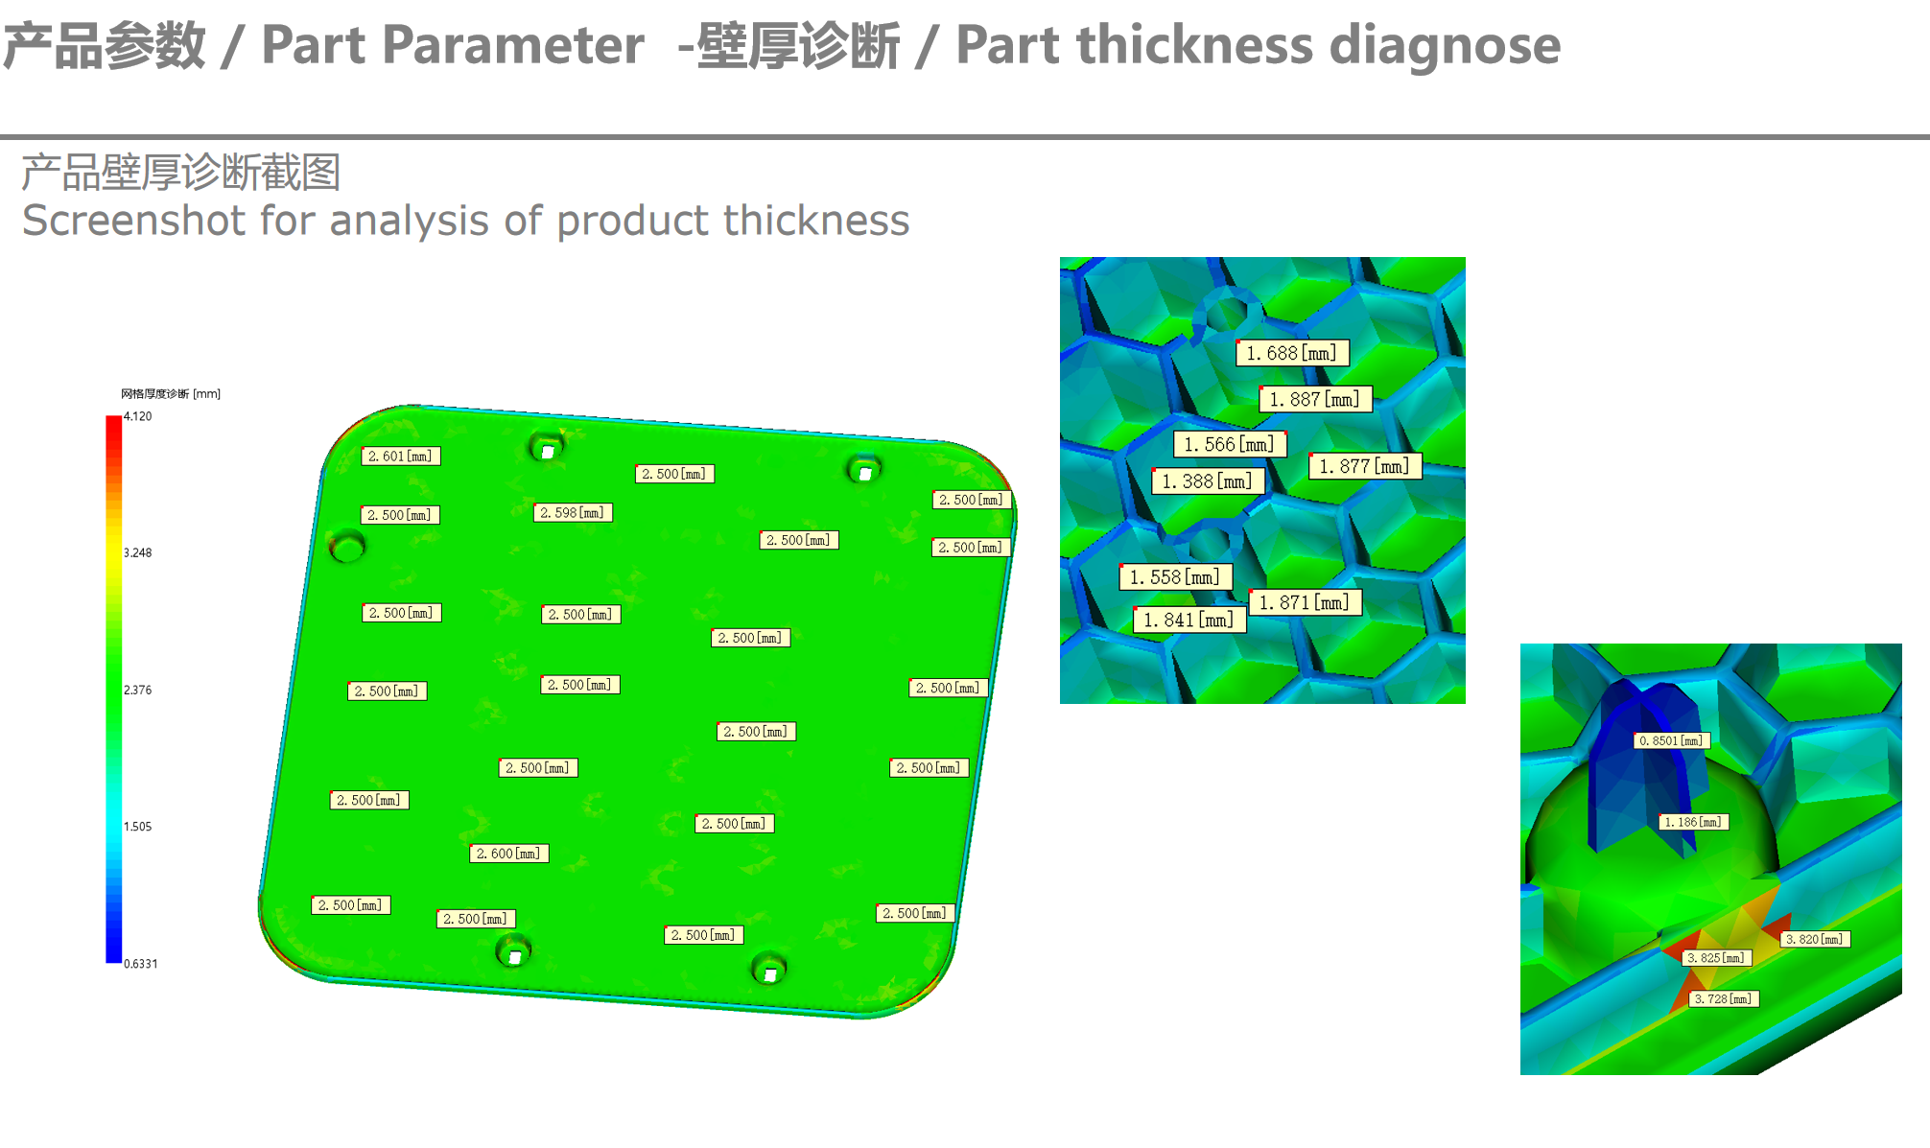
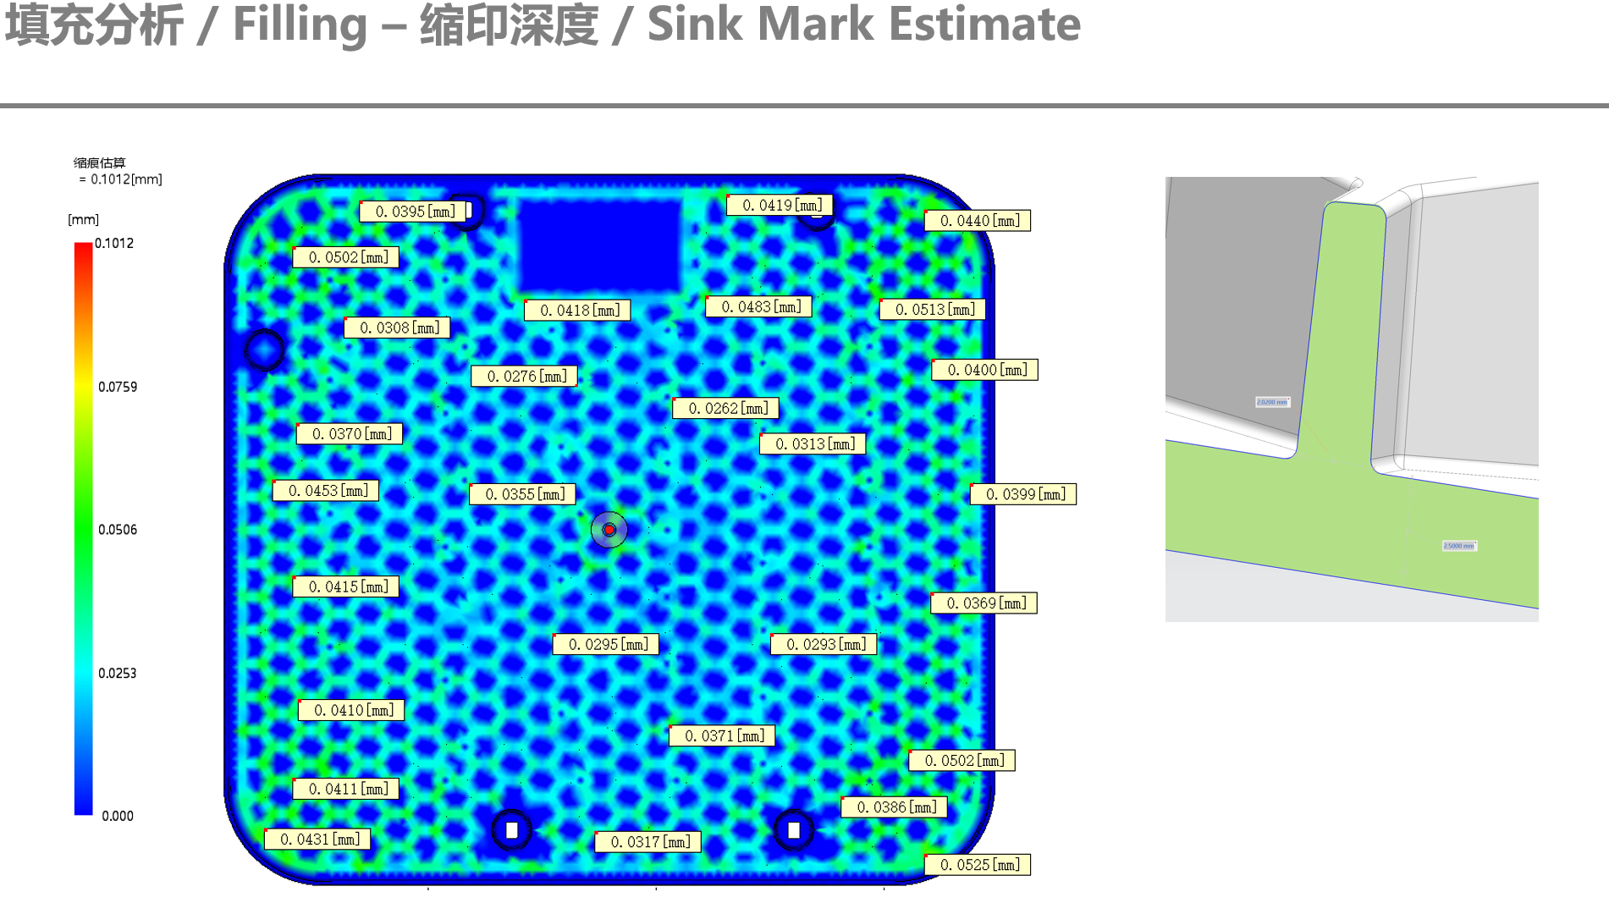
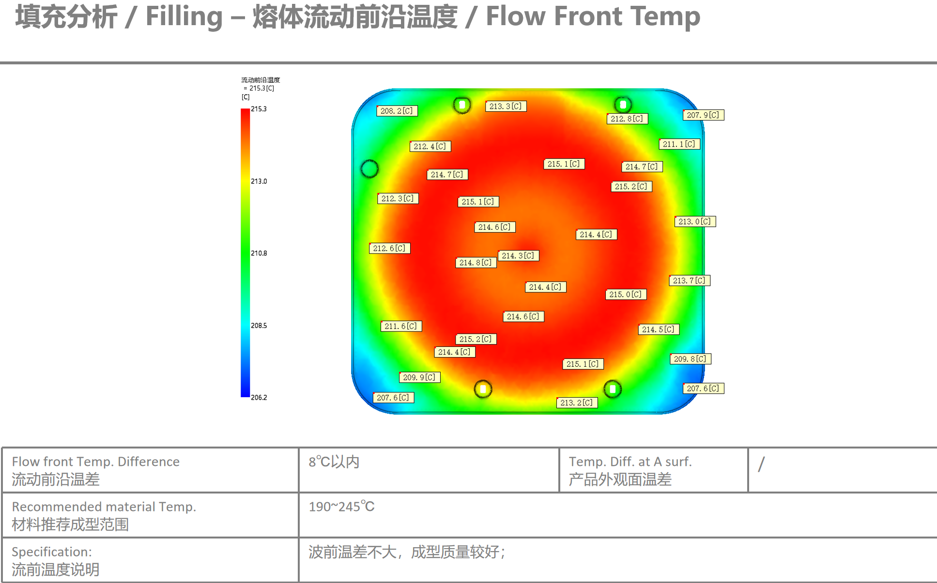
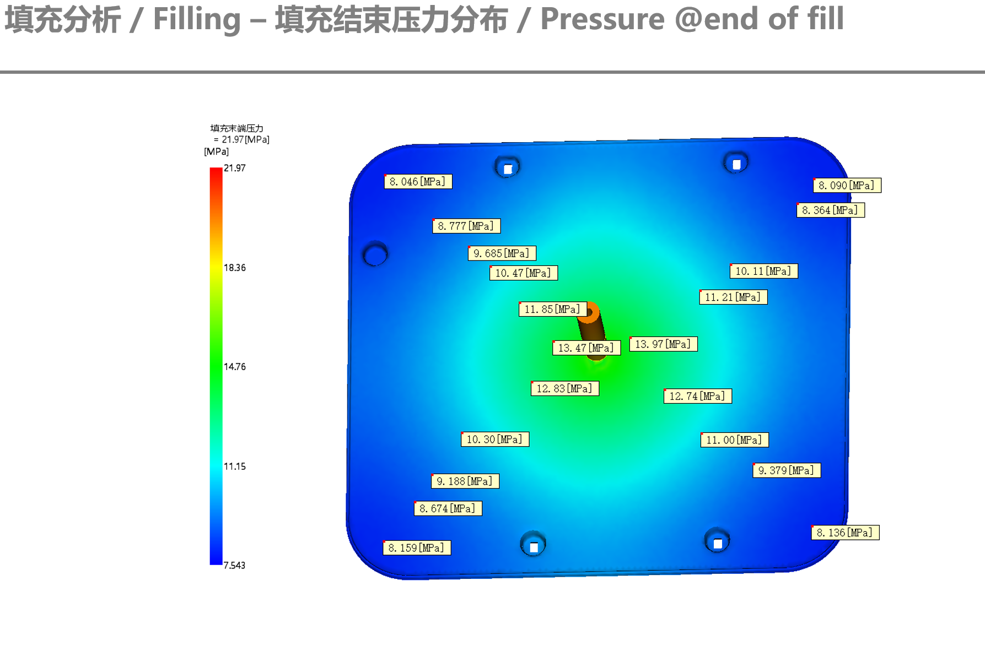
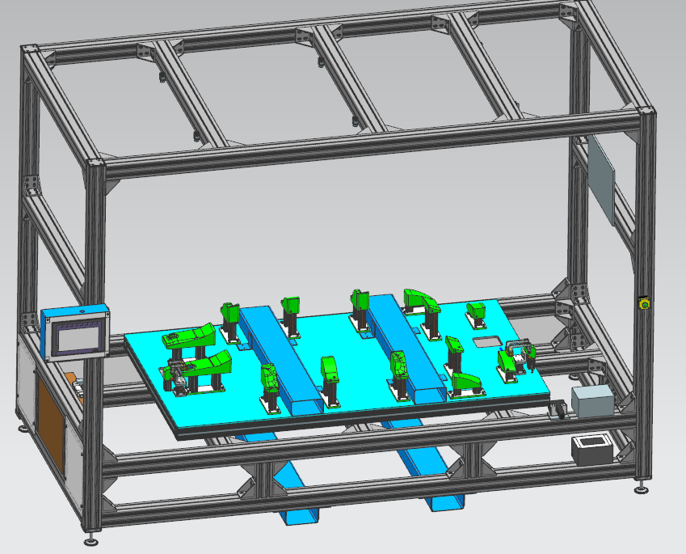
4. Similar Product Experience
Plastic injection molding - Similar Parts
Mold Flow
Thickness
Shrink Mark
Clip Assembly Fixture
Tempreture
Pressure
Video Inspection Fixture

Slide 16
CONTENTS
PART 05
PACKAGING & LOGISTICS

Slide 17







5. Packaging & Logistics
CPT Shanghai Lingang JLR IEO Warehouse
JLR IEO Warehouse
Shanghai Lingang
Logistics hub
Jinrong
Shanghai
Plant
JLR Nitra Slovakia
Plant
Pacakage: Expendable Package

Slide 18
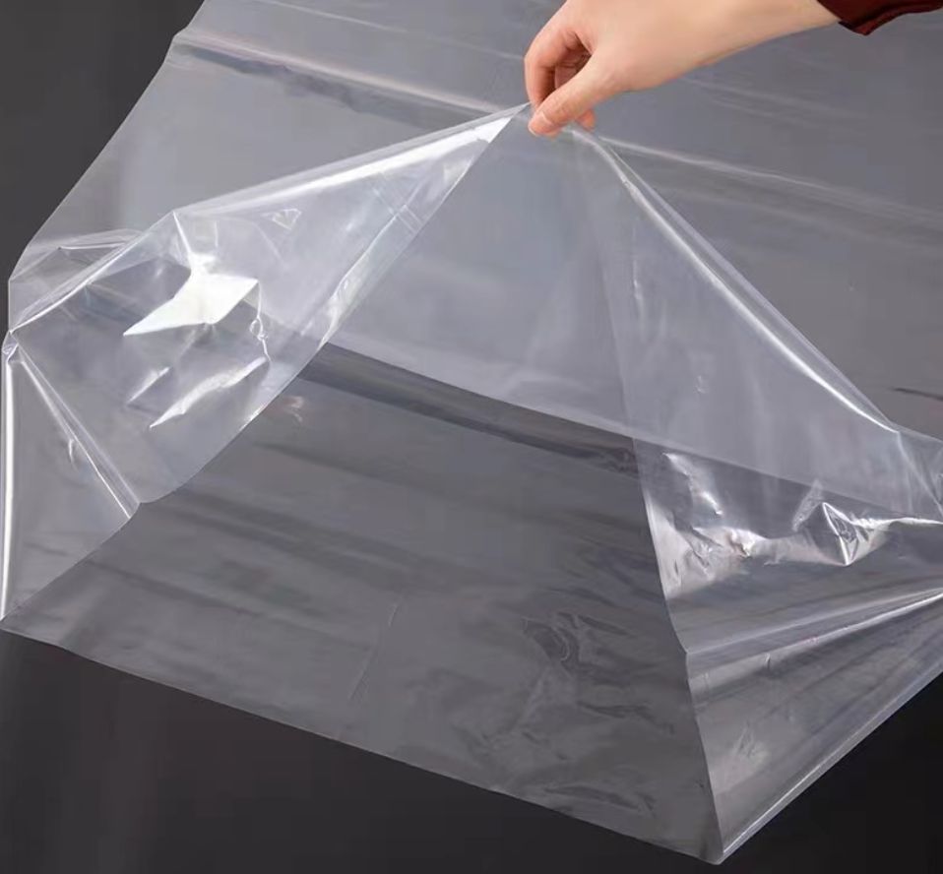

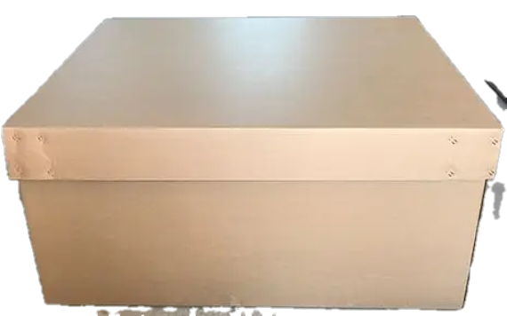
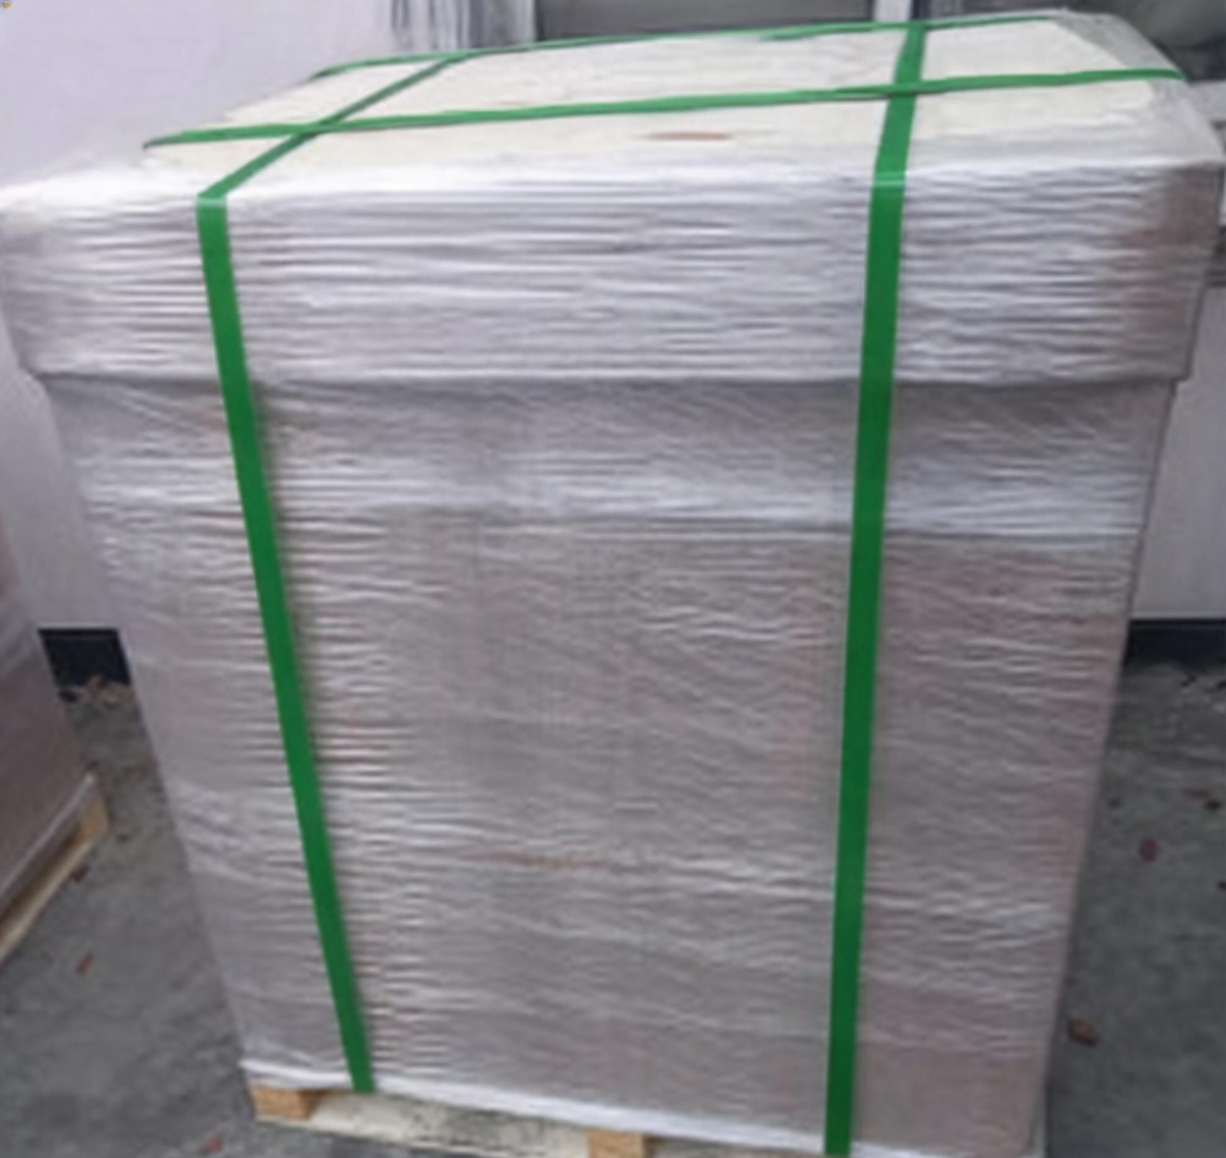
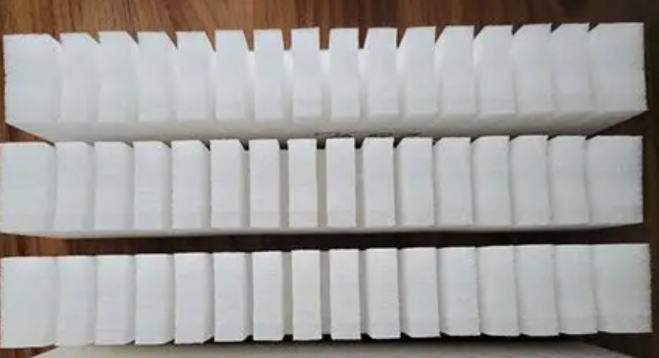
5. Packaging & Logistics
Packaging Specifications
Part basic information
Part Number | Z7B2-13A994-A-INS-01 | Part Length(cm) | 49 | Part Width(cm) | 33
Part Height(cm) | 5.7 | Part Weight(kg) | 0.46 | Package Type | Expendable
Transport Mode | Sea freight | Part Material | ABS/PA66/Steel | Effective From
Photograph/Sketch
Part Images |  | Open Box with Parts & Dunnage |  | Primary Packaging photo
External Packaging Images |  | Complete Unit Load /Pallet |  | Additional Images
Primary Packaging - Individual Container
Package Material | PE bag | Tare Weight (kg) | 0.45 | Total weight(kg) | 0.46
package length(cm) | 215 | package width(cm) | 140 | Package height | 0.04mm
No. of Containers per Layer | / | No. of Layers | / | QPC | 1
Second Packaging - External container
Package Material | carton box | Tare Weight (kg) | 9.2 | Total weight(kg) | 10.0
package length(cm) | 1140 | package width(cm) | 940 | Package height(cm) | 410
No. of Containers per Layer |  | No. of Layers | 1 | Density: (parts/carton) | 32
Cube Packaging Information
Pallet Type | four way | Pallet Element | wood | Banding Type | Stretch-Film
Pallet Length(cm) | 1140 | Pallet Width(cm) | 940 | Pallet height(cm) | 130
Cartons per Layer | 1 | Layers per Pallet | 1 | Density: (parts/pallet) | 32
Additional Comments

Slide 19
CONTENTS
PART 06
6.1 DVP
VALIDATION

Slide 20
6.1 DVP
-Performance Requirements of Non-Decorated Plastics - component level tests
 |  | Material Tests (plaques)
 |  | 1 | 1 | 1 | 1 | 1 | 1 | 1 | 1 | 1 |  | 1 |  | 1 |  |  |  | 4 plaques
Duration |  | 3 days | 1 week | 2 weeks | 6 weeks | 1 day | 1 day | 1 day | 3 weeks | 1 day | 1 day | 1 day | 1 day | 1 day | 1 day | 1 day | 1 day | 2 days | 2 days | 1 day | 3 days | 3 days
Test Name |  | Resistance to Weathering |  |  |  | Micro-scratch | Scratch | Mar | Heat Age | Fluid Spotting |  | Fluid Spotting |  | Resistance of Interior Trim to Perspiration |  |  |  | Fogging - Gravimetric | Odour |  | VIAQ | Total VOC
Test Method |  | SAE J2412 |  |  |  | TPJLR.52.009 | TPJLR.52.008 | TPJLR.52.010 | TPJLR.52.352 | TPJLR.52.155 |  | TPJLR.52.155 |  | TPJLR.52.156 |  |  |  | SAE J1976 | VDA 270 |  | TPJLR.52.104 | VDA277
Description |  | 110 kJ/m² | 220 kJ/m² | 440 kJ/m² | 1430 kJ/m² | Method A | Grained only |  | 500 hrs colour assessment | Water 23 ºC | Soap 23 ºC | Water 60 ºC | Soap 60 ºC | Water | Salt | Acid | Alkali |  | 40C | 80C
Component Level Status/Report - Materials Engineering Comment |  | GS 4 min |  |  | GS 3/4 min | High gloss only No scratch | dL +0.5 max | dG 1.0 max | GS 4 min | GS 4 min |  | GS 4 min |  | GS 4 min |  |  |  | Meet requirements of STJLR.51.5229
 |  |  |  |  |  |  |  |  |  |  |  |  |  |  |  |  |  | JLR |  | JLR | JLR | JLR
 |  | Component Tests
Duration |  | 10 days | 7 days | 3 days | I day | I day | 3 days | 4 days
Test Name |  | Assembly Test |  | Hygroscopic materials only - Assembly Test | Grained only |  | Parts wth Metal fixings only
Test Method |  | TPJLR.52.353 | TPJLR.52.352 | TPJLR.52.351 | TPJLR.52.008 | TPJLR.52.010 | See STJLR.00.5235 for details
Description |  | Accelerated Environmental Ageing | Resistance to Heat Ageing | Resistance to Humidity | Scratch | Mar | Corrosion - 72 hrs humidity | Cyclic Corrosion - 4 cycles for wet areas
Component Level Status/Report - Materials Engineering Comment |  | 168 hrs Assess for distortion etc |  |  | dL +0.5 max | dG = 0.6 max
 |  | Supplier | Supplier |  | Supplier | Supplier
Test evaluation completed; no issues detected.
Question: The tests not indicated RASIC are done by JLR or JINRONG

Slide 21

THANK YOU！
Company Address
No. 58, Lane 2400, Baoan Highway, Baoshan District. Shanghal, China 201907
Presented by: Yang WANG | Tracy Wang
Mobile: +86 18516530077 | +86 15921853685
Email: wangyang@jinronggroup.cn | tracy@jinronggroup.cn

